Slide 1
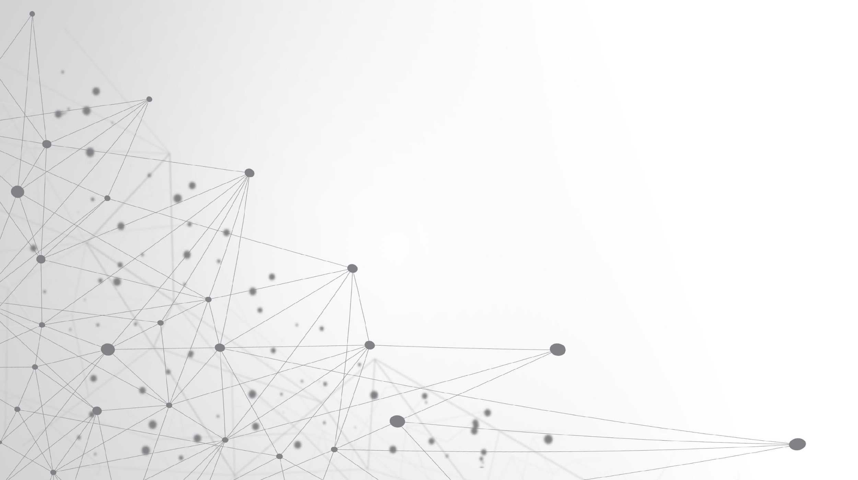
Geometric Deep Learning
Going Beyond Euclidean

Slide 2
History Of Geometry
For almost 2000 years, "geometry" was synonymous with Euclidean geometry.
Euclid's monopoly ended in the nineteenth century with the introduction of non-Euclidean geometries by Lobachevsky, Bolyai, Gauss, Riemann, and others.
The development of projective geometry led to the emergence of different geometries.
Mathematicians debated the true nature of geometry and what defines it.
Felix Klein proposed the Erlangen program in 1872.
Geometry was approached as the study of invariants or symmetries.
Different geometries could be defined by an appropriate choice of symmetry transformations.
Group theory provided a formal language to describe these transformations.

Slide 3
Impact of Erlangen’s Work
The Erlangen program had a profound impact on geometry and mathematics.
It extended into other fields, especially Physics, Chemistry.
Symmetry considerations in physics led to the derivation of conservation laws (Noether's theorem).
The concept of gauge invariance, developed by Yang and Mills, unified fundamental forces (except gravity) in the standard model.
Similar to the situation in 19th-century geometry, deep learning lacks unifying principles.

Slide 4
Why is Geometric Deep Learning ?
Traditional deep learning methods are designed to work on data that is represented in a Euclidean space, where points can be easily compared to each other using distance metrics. However, non-Euclidean data does not have a natural distance metric, and so traditional deep learning methods cannot be used directly.
The non-Euclidean nature of such data implies that there are no such familiar properties as global parameterization, common system of coordinates, vector space structure, or shift-invariance.

Slide 5
What is Geometric Deep Learning
Geometric deep learning is a subfield of machine learning that focuses on developing deep learning models for data that is not naturally represented in Euclidean space. This type of data is often found in natural and social sciences, where objects and relationships are often represented as graphs or manifolds.
Geometric deep learning is an umbrella term for emerging techniques attempting to generalize (structured) deep neural models to non-Euclidean domains such as graphs and manifolds.

Slide 6
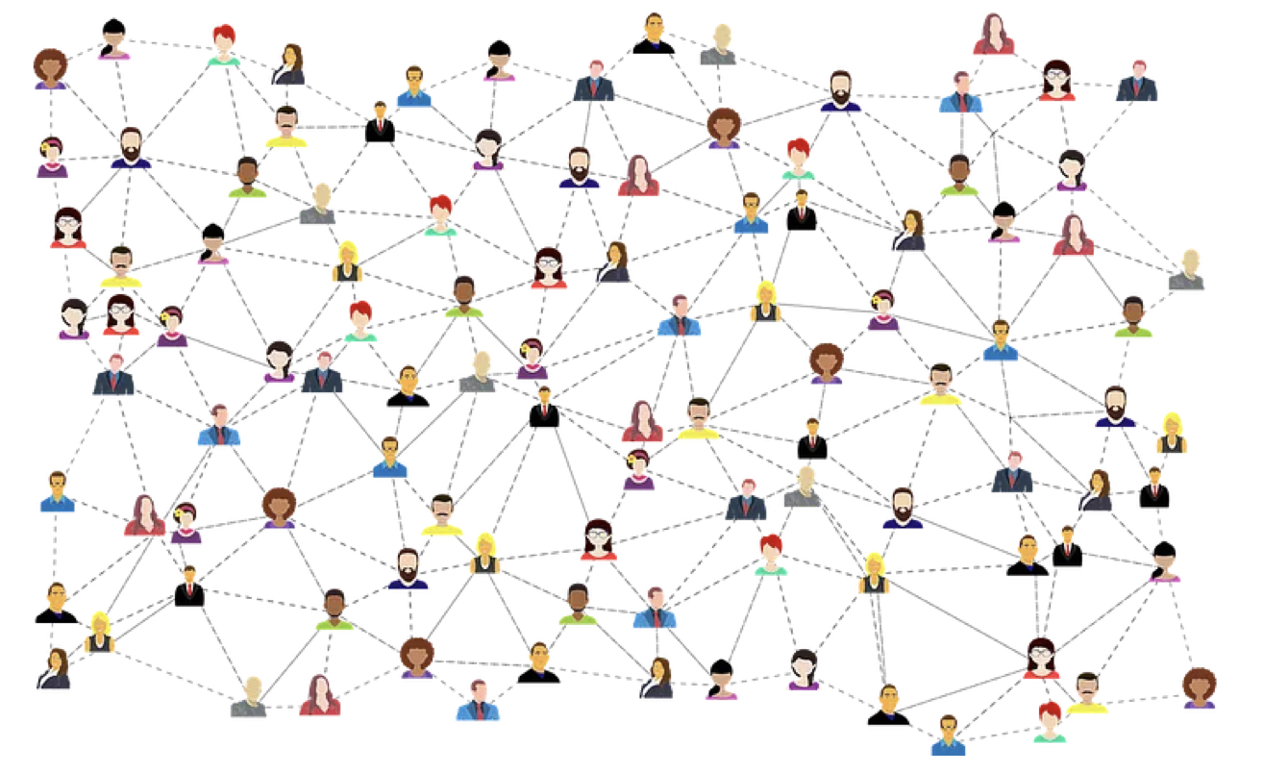

Slide 7
Graph in Geometric Deep Learning
Graphs model relations and interactions, such as social networks.
Nodes represent users, and edges capture relationships.
Graphs lack canonical node ordering, requiring permutation invariance and equivariance.
Local aggregation functions capture neighborhood information.
In natural language processing, words in a corpus can be represented by the co-occurrence graph, where two words are connected if they often appear near each other.
Geometric deep learning has the potential to be used to solve a wide range of problems in natural and social sciences. For example, geometric deep learning could be used to develop models of social networks, brain networks, and gene regulatory networks.

Slide 8
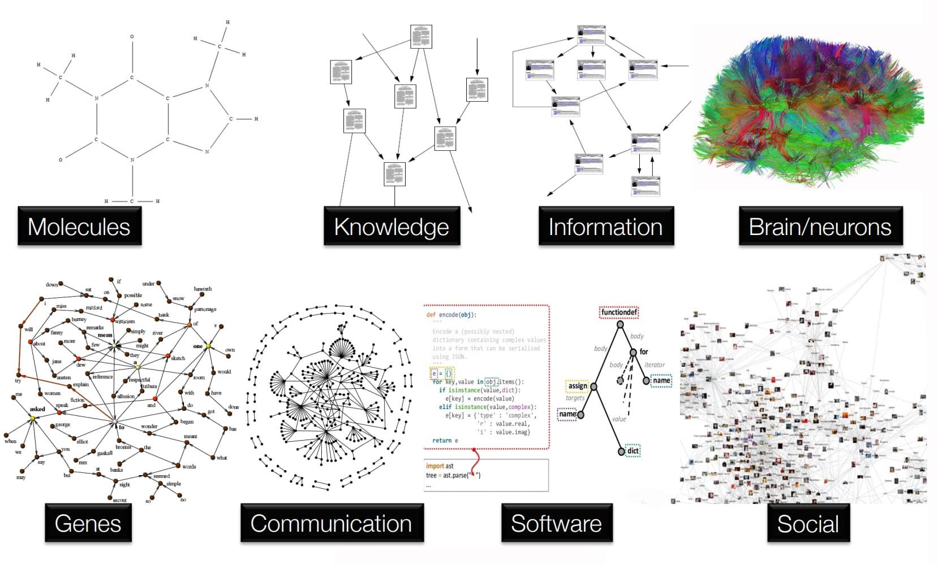

Slide 9
Equivariance in Geometric Deep Learning
A Property of the neural network where the function being applied to the graph changes in the same way as the input graph with the reordering of the nodes. In other words, an equivariant function on a graph produces outputs that are transformed in a consistent manner when the input graph undergoes node permutations.
Equivariance ensures that the neural network can capture and preserve the structural information of the graph, regardless of the ordering of the nodes. It allows the network to learn patterns and relationships that are invariant under node permutations, making it suitable for tasks such as node classification, link prediction, and graph-level predictions.

Slide 10
Invariance in Geometric Deep Learning
A property of the neural network where the learned representation or output remains unchanged when the input graph undergoes certain transformations or operations.
Invariance ensures that the neural network focuses on capturing and learning the essential features or properties of the graph that are preserved under specific transformations. For example, if the graph is invariant to node permutations, it means that the network's output should not depend on the ordering of the nodes.
By enforcing invariance, graph neural networks can generalize well and make robust predictions despite variations in the graph structure. This property is particularly important in scenarios where the order or arrangement of the nodes is not meaningful or can vary, such as when dealing with molecular graphs or social network data.
Concretely, some properties like energy of an atomistic system should be constant regardless of how we shift the system; others like force should be rotated accordingly if we rotate the system. To incorporate these inductive biases, equivariant and invariant neural networks have been proposed.

Slide 11
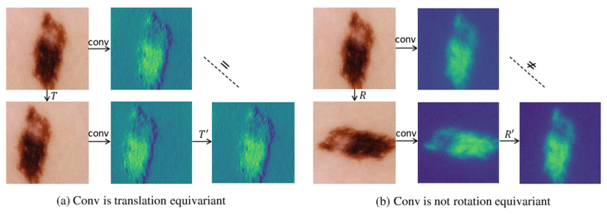

Slide 12
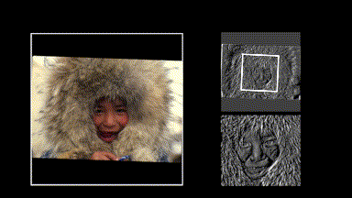

Slide 13
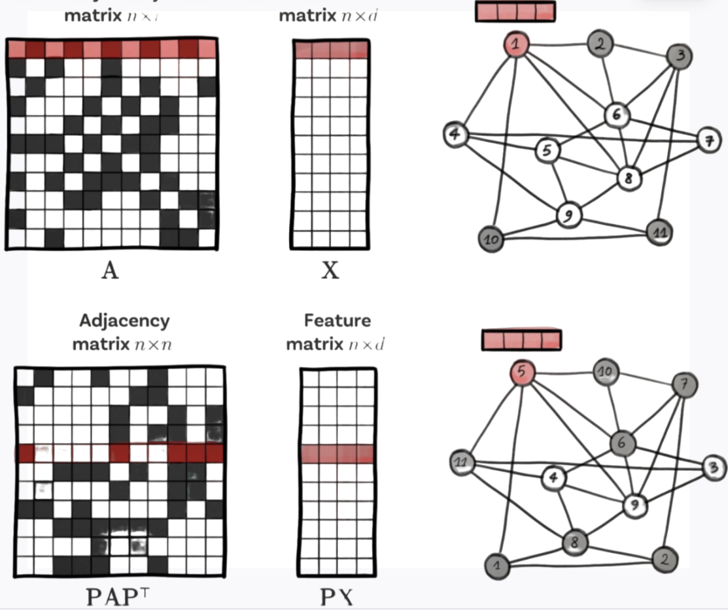
Why we don’t use Adjacency List for graph Structure ?

Slide 14
Message Passing, Embeddings in GNN
GNNs work by propagating information through the graph. This is done using a process called message passing. In message passing, each node in the graph sends a message to its neighbors. These messages contain information about the node's features and its local neighborhood. The neighbors then update their own features based on the messages they receive. This process is repeated for multiple rounds, until the desired level of accuracy is achieved.
Embeddings are low-dimensional representations of data that can be used for tasks such as classification, clustering, and recommendation. Embeddings are learned by propagating information through the graph.

Slide 15
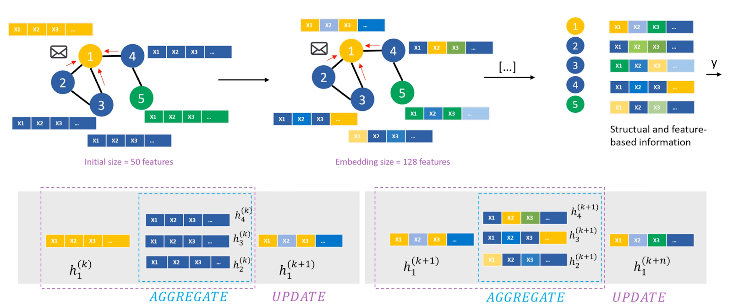
How Message a Passing Works ?

Slide 16
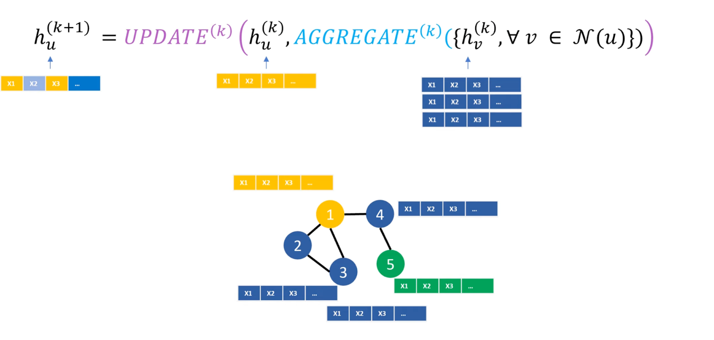
Equation used in Message Passing

Slide 17
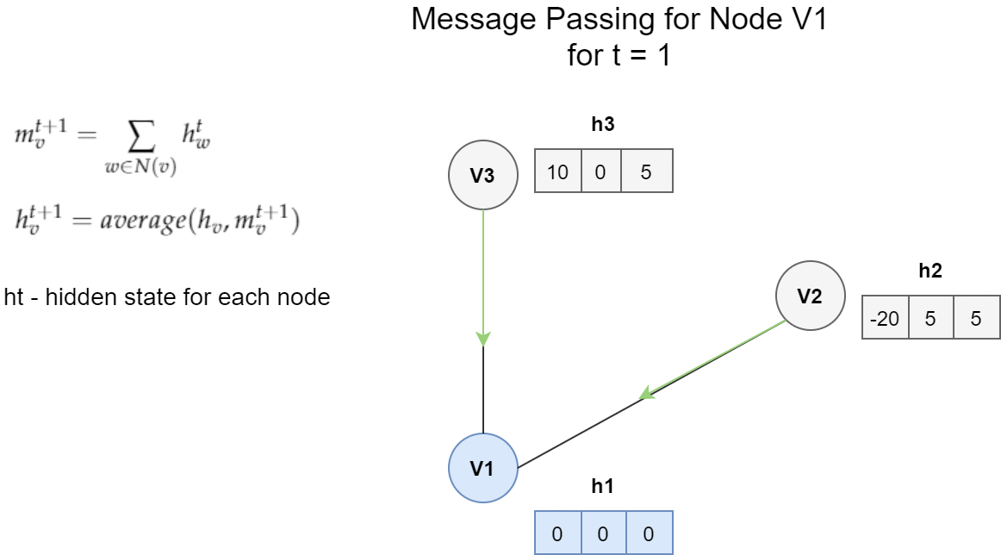
Example…

Slide 18
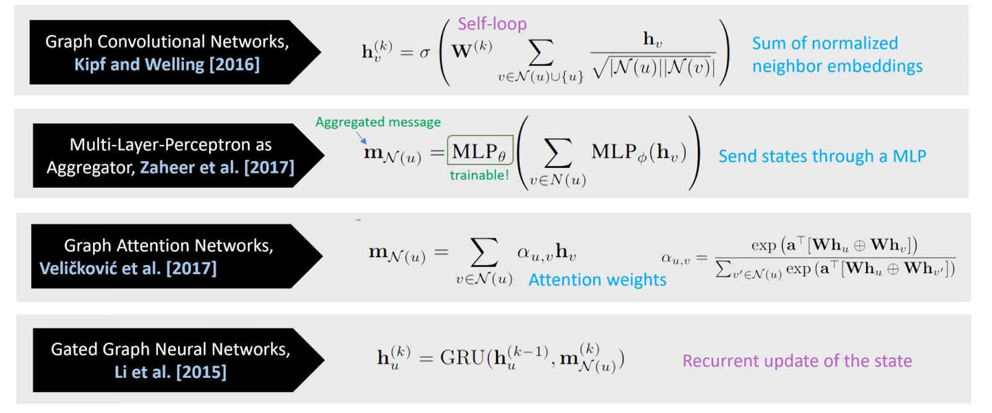
Variations of different Aggregation and Updation Functions:

Slide 19
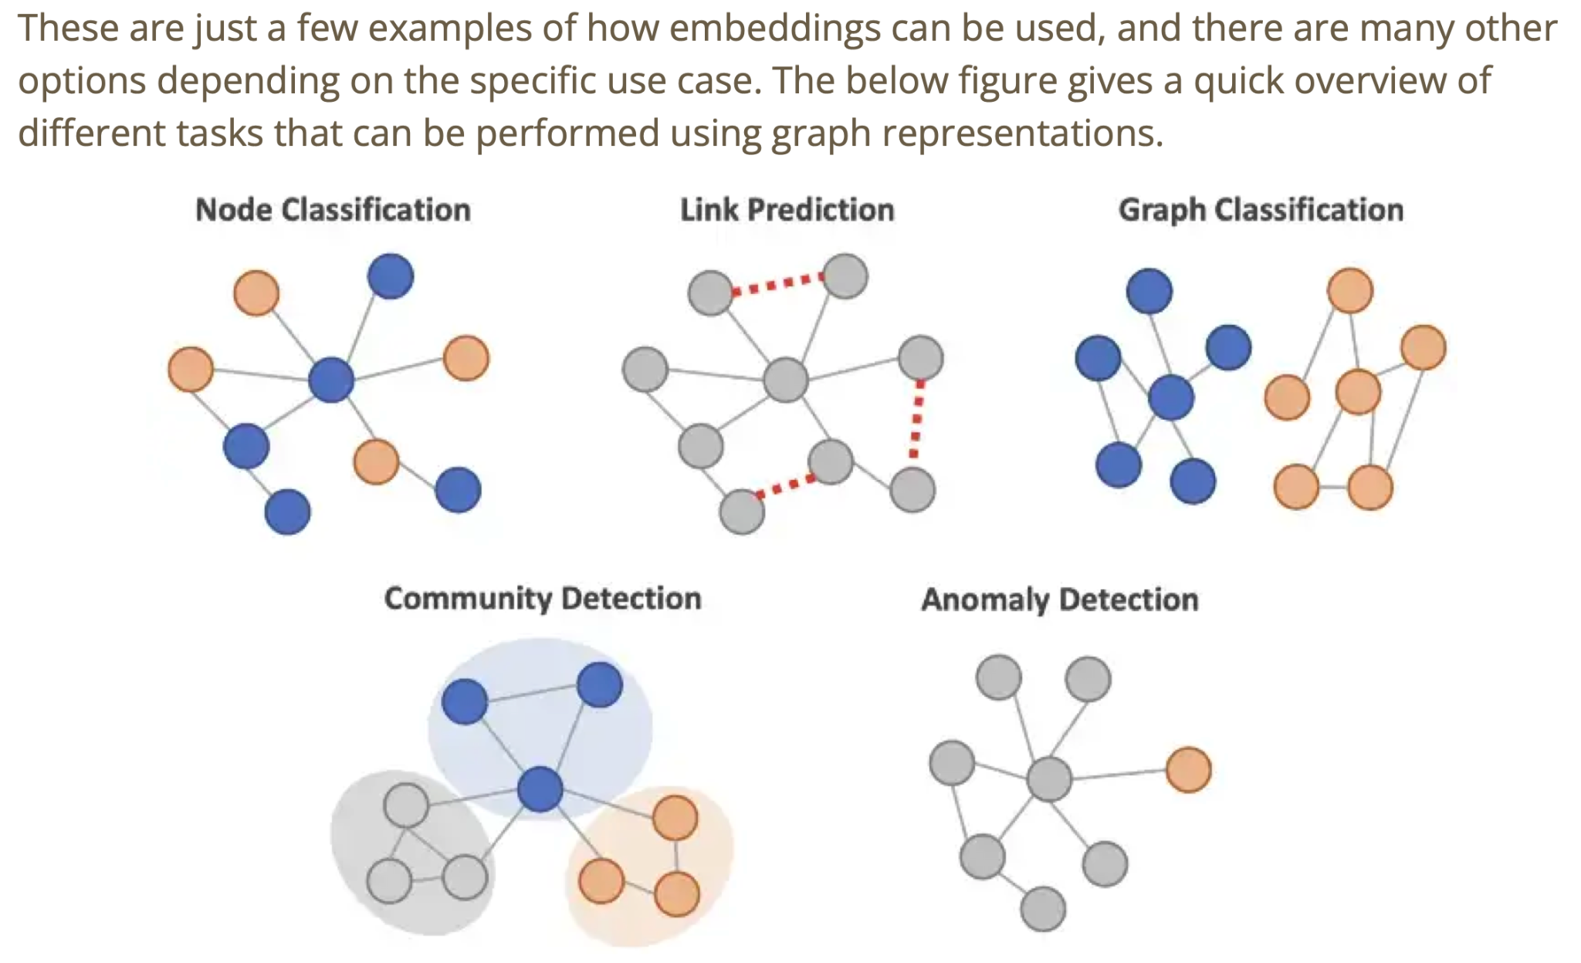

Slide 20
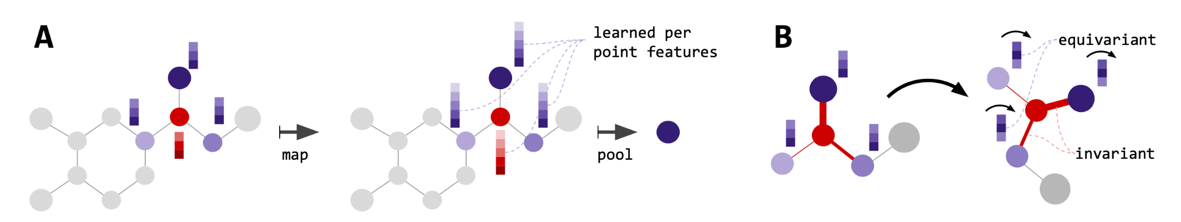
Attention…
Self-attention mechanisms have enjoyed a sharp rise in popularity in recent years. Their relative implementational simplicity coupled with high efficacy on a wide range of tasks such as language modeling, image recognition or graph-based problems, make them an attractive component to use.
Permutation equivariance: A key property of self-attention is permutation equivariance. Permutations of point labels 1, ..., n lead to permutations of the self-attention output. This guarantees the attention output does not depend arbitrarily on input point ordering. Wagstaff et al. [33] recently showed that this mechanism can theoretically approximate all permutation equivariant functions. The SE(3)-transformer is a special case of this attention mechanism, inheriting equivariance.

Slide 21
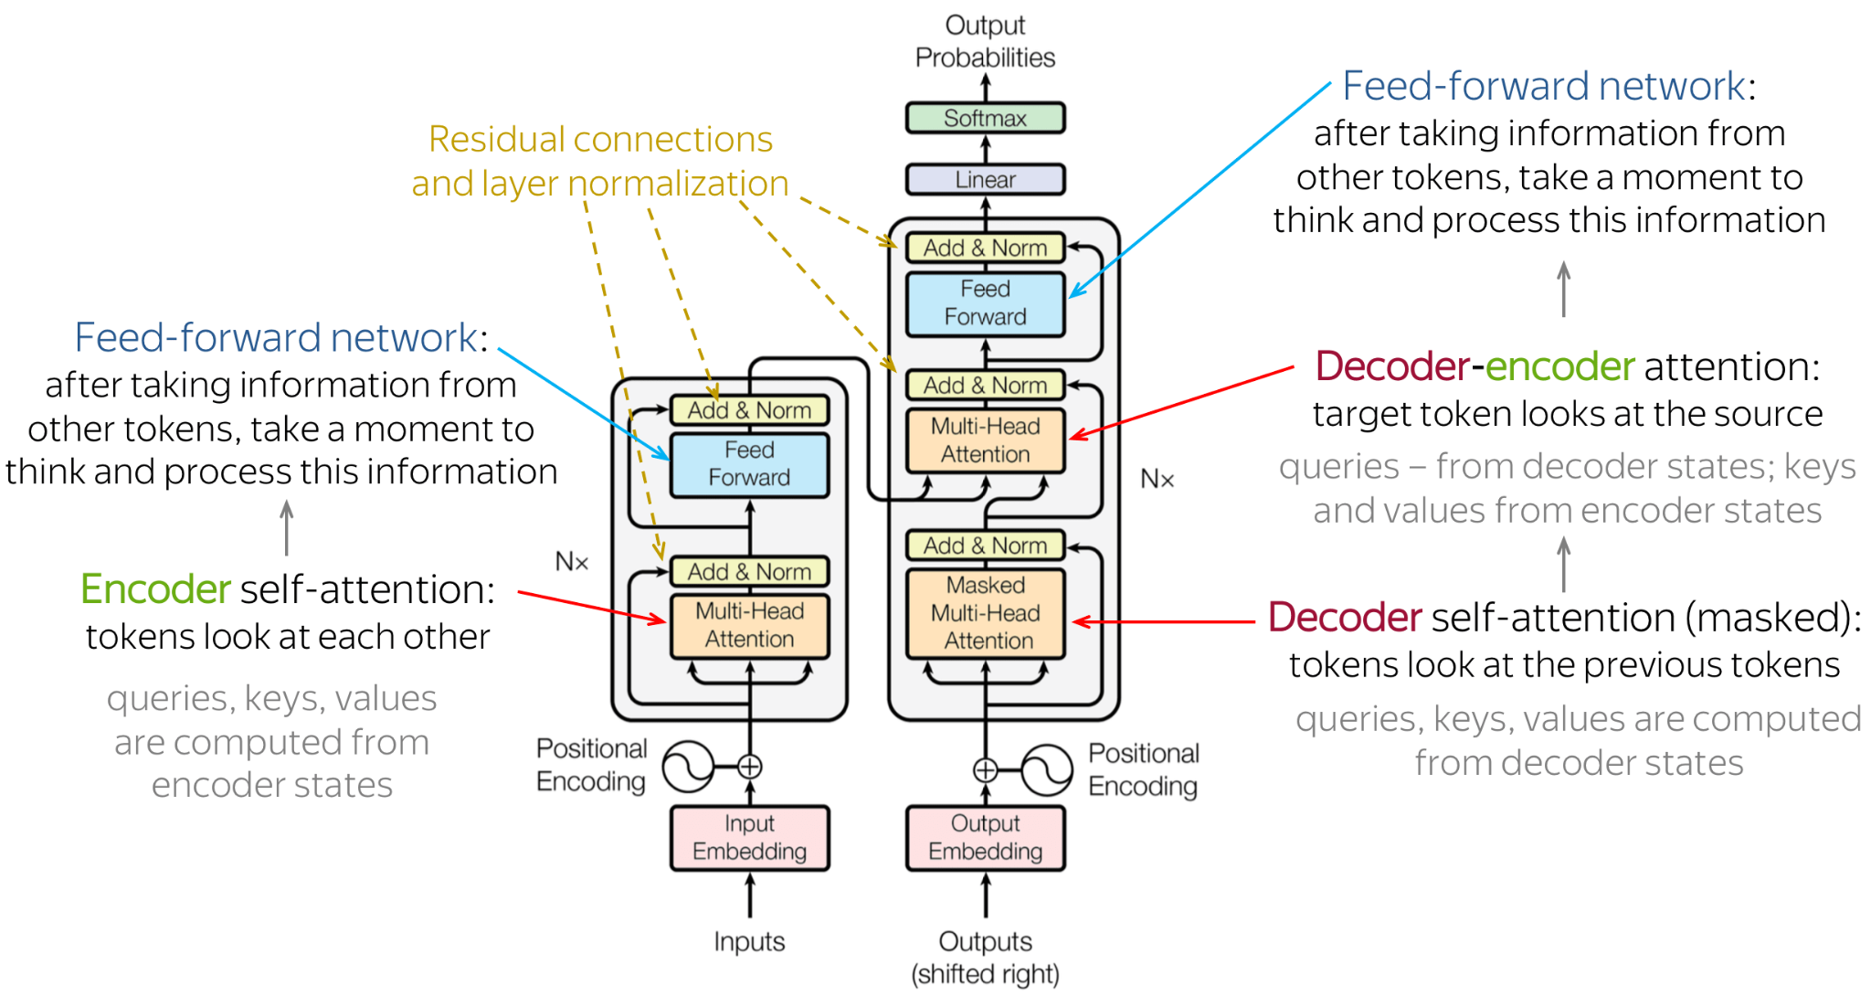

Slide 22
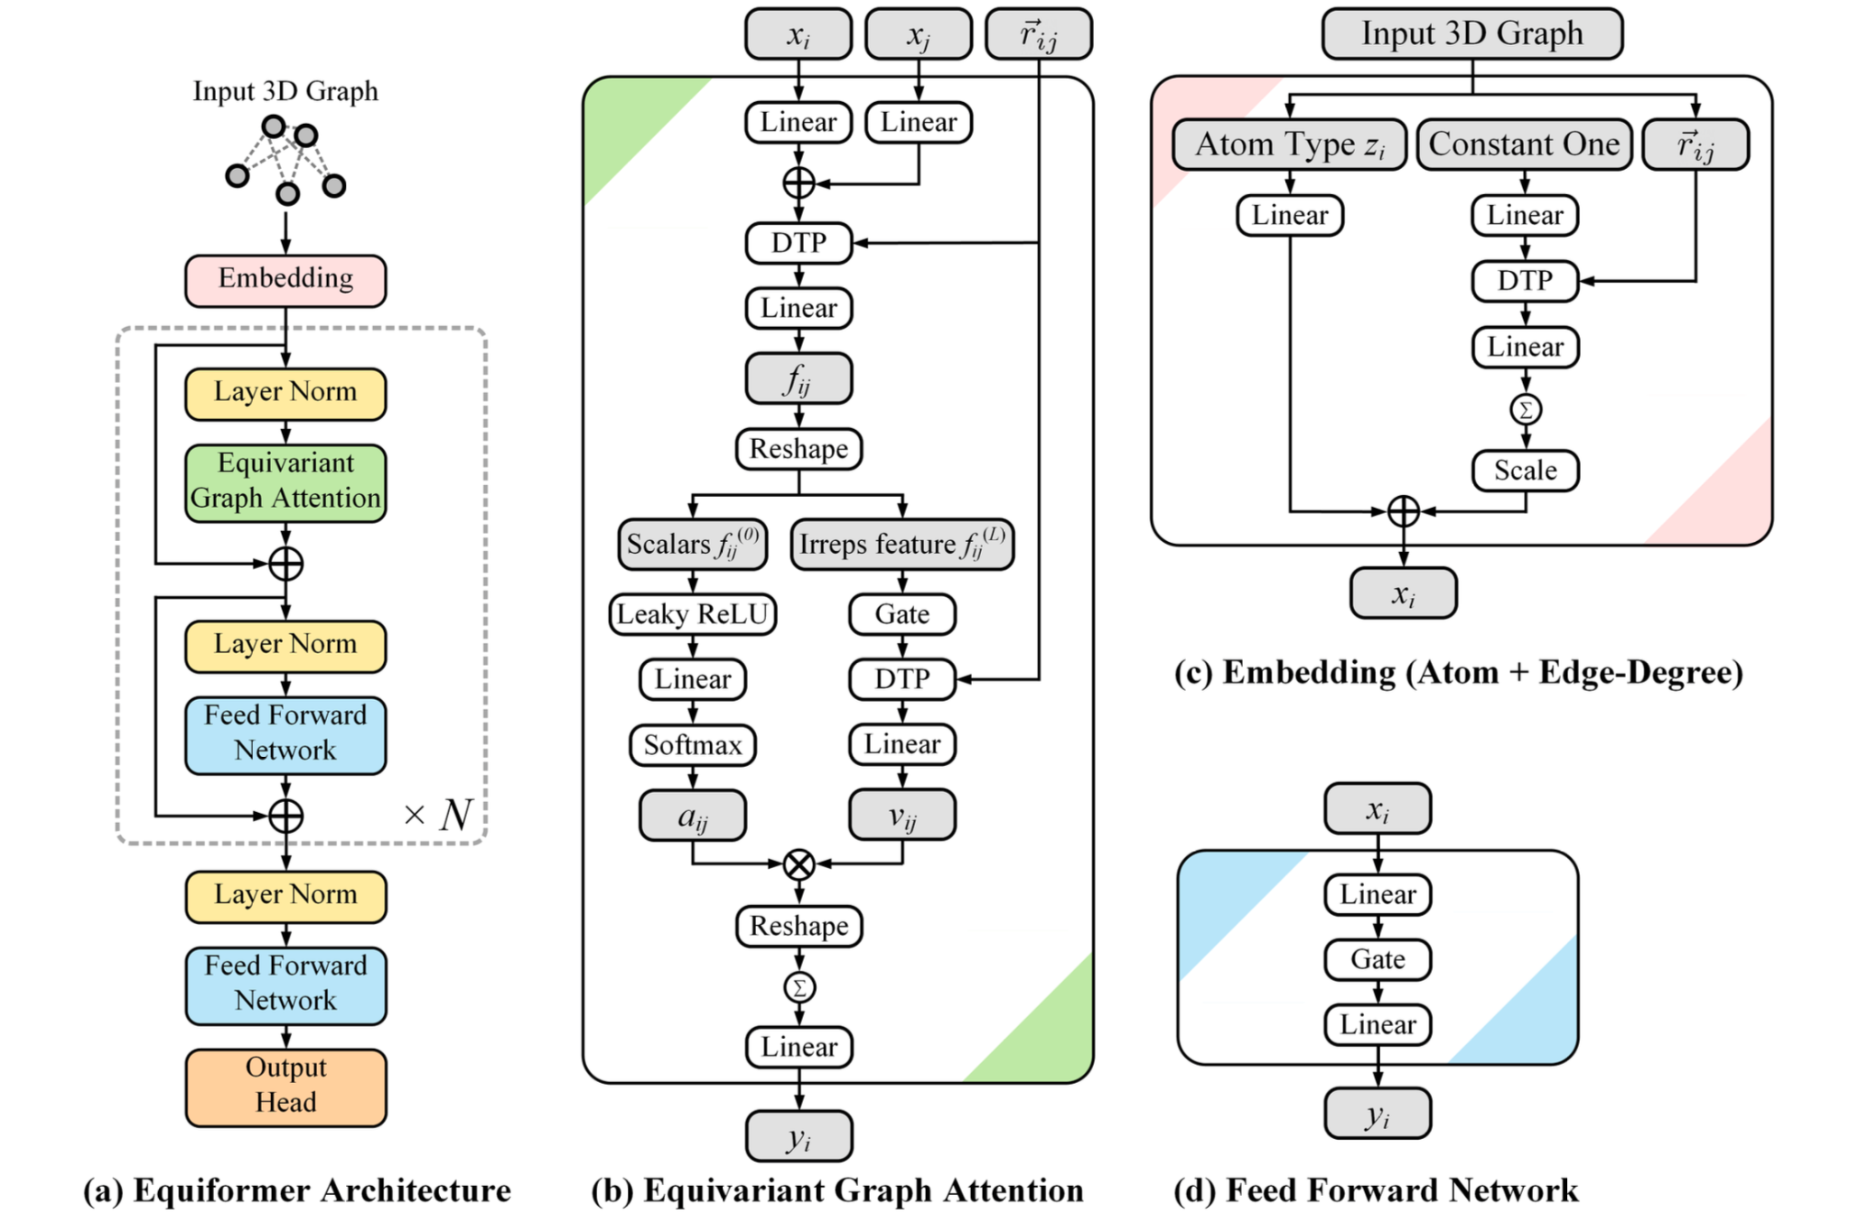

Slide 23
My Project in this Internship
Learning - Geometric Deep Learning, GNN,
Multi-headded Attention, Transformers Architecture.
Adding Attention to SE(3)-GNN Model.
Testing proposed model on various Datasets like:
ScanObjectNN and QM9, MD17 and OC20 datasets.
Comparison of proposed model with existing state of the art models
Summarise findings in a Research Paper
Notes:
Entered text
Foundations of Machine Learning
Supervised learning
Unsupervised learning
Reinforcement learning
Classification vs. regression problems vs clustering
Essential Concepts in Machine Learning including the given below with formulas and graphs wherever necessary
Training data, testing data, and validation data
K-fold CV
Feature extraction and selection
Evaluation metrics (accuracy, precision, recall, F1 score)
Overfitting and underfitting and generalization
Bias-variance tradeoff
Basic ML algorithms with their mathematical formula and graphs:
Linear regression, logistic regression
KNN
Basics of DT, RF
Ensemble learning
K-means clustering

Slide 24
THANK YOU!
Special Thanks to Ramzan Sir

